Slide 1
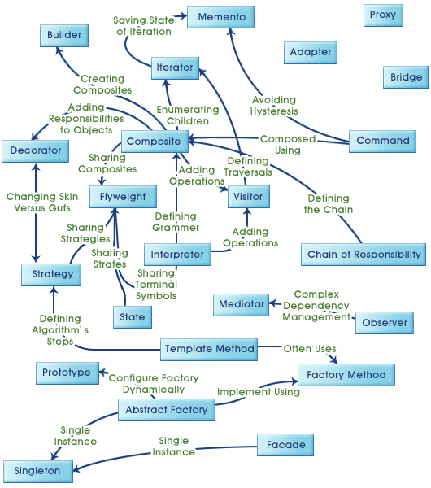
Design Pattern
Galactica
/
April 8, 2016

Slide 2
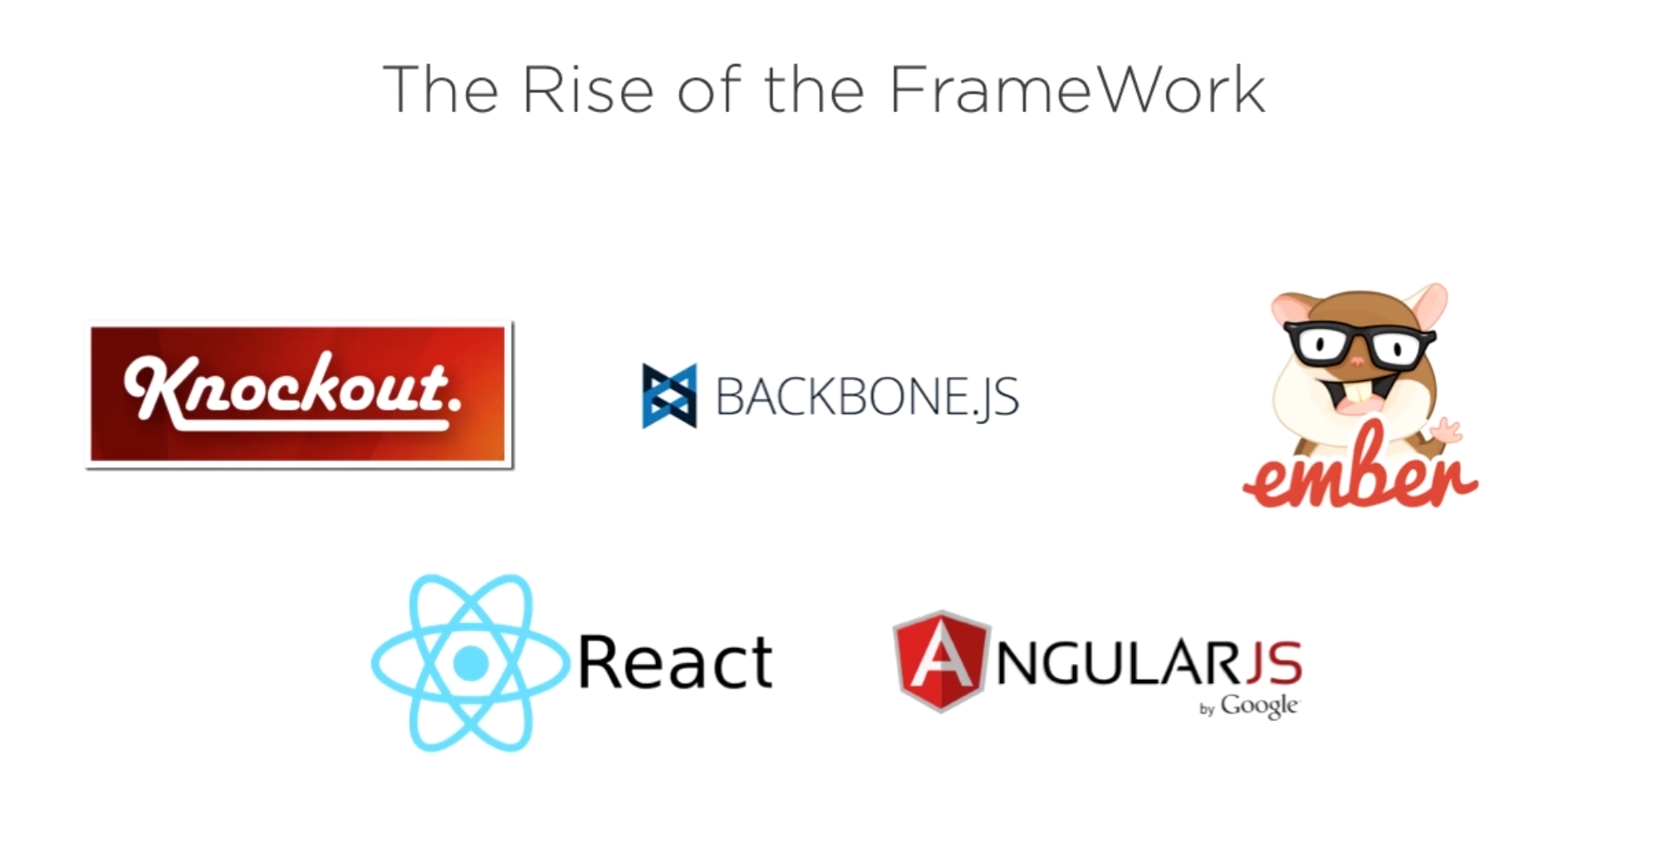
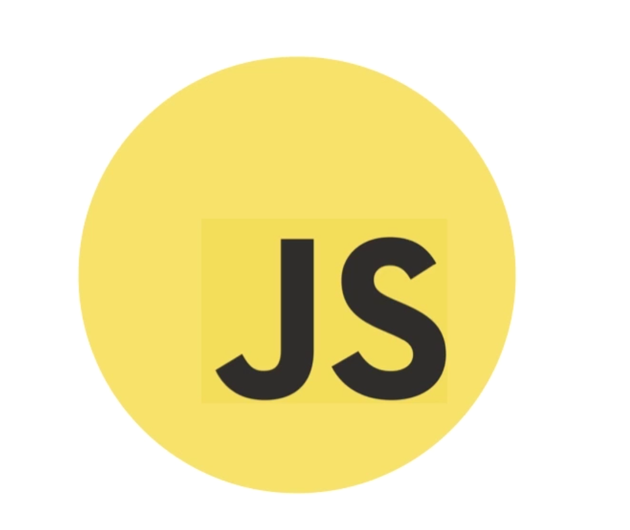

Slide 3
Design Patterns
To The Rescue

Slide 4
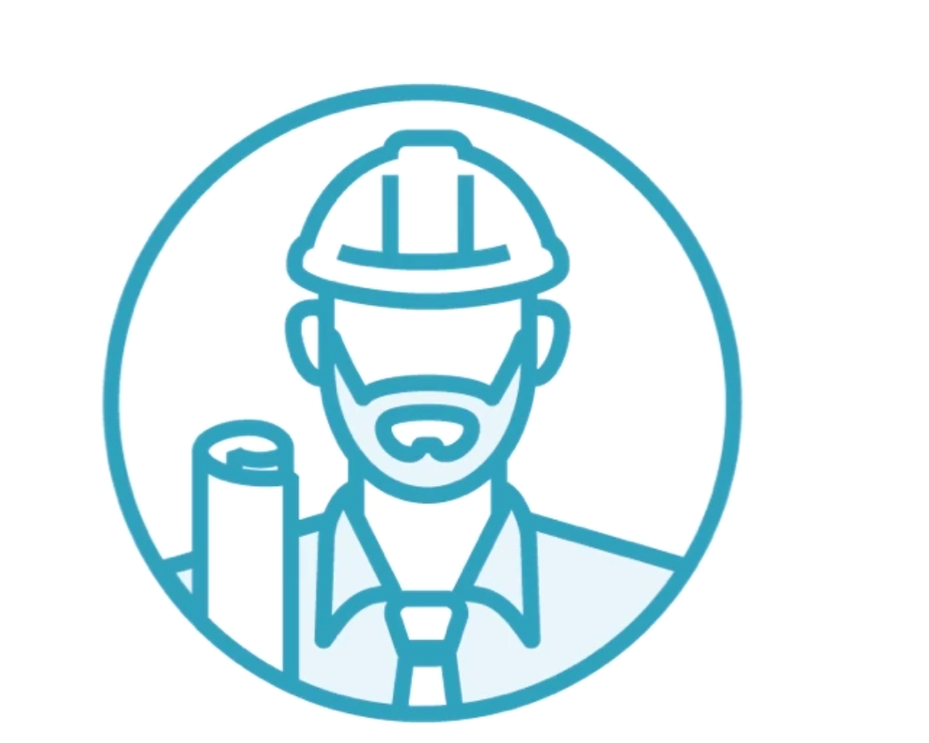
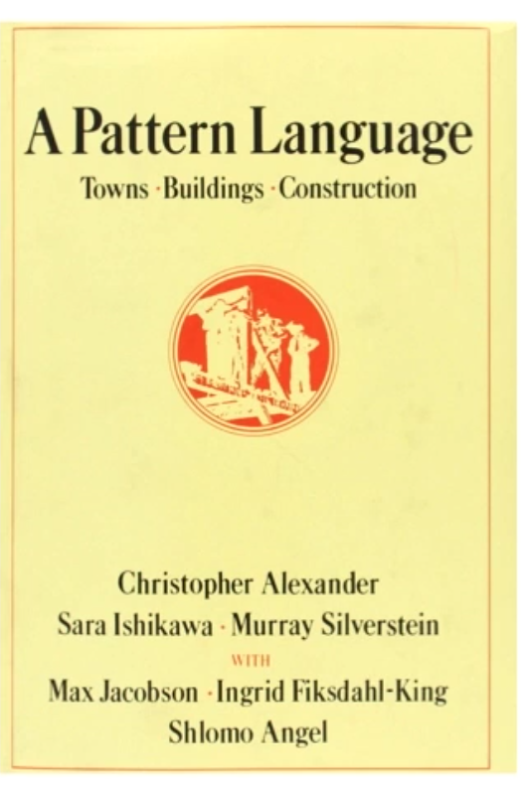
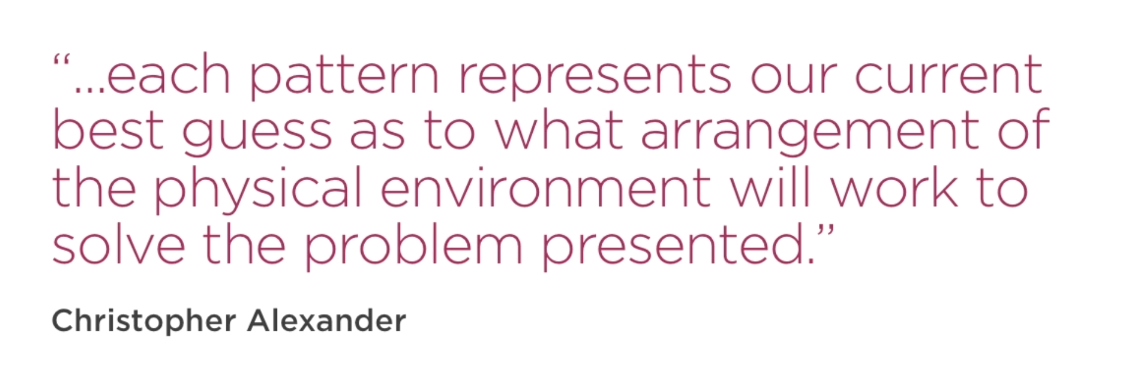
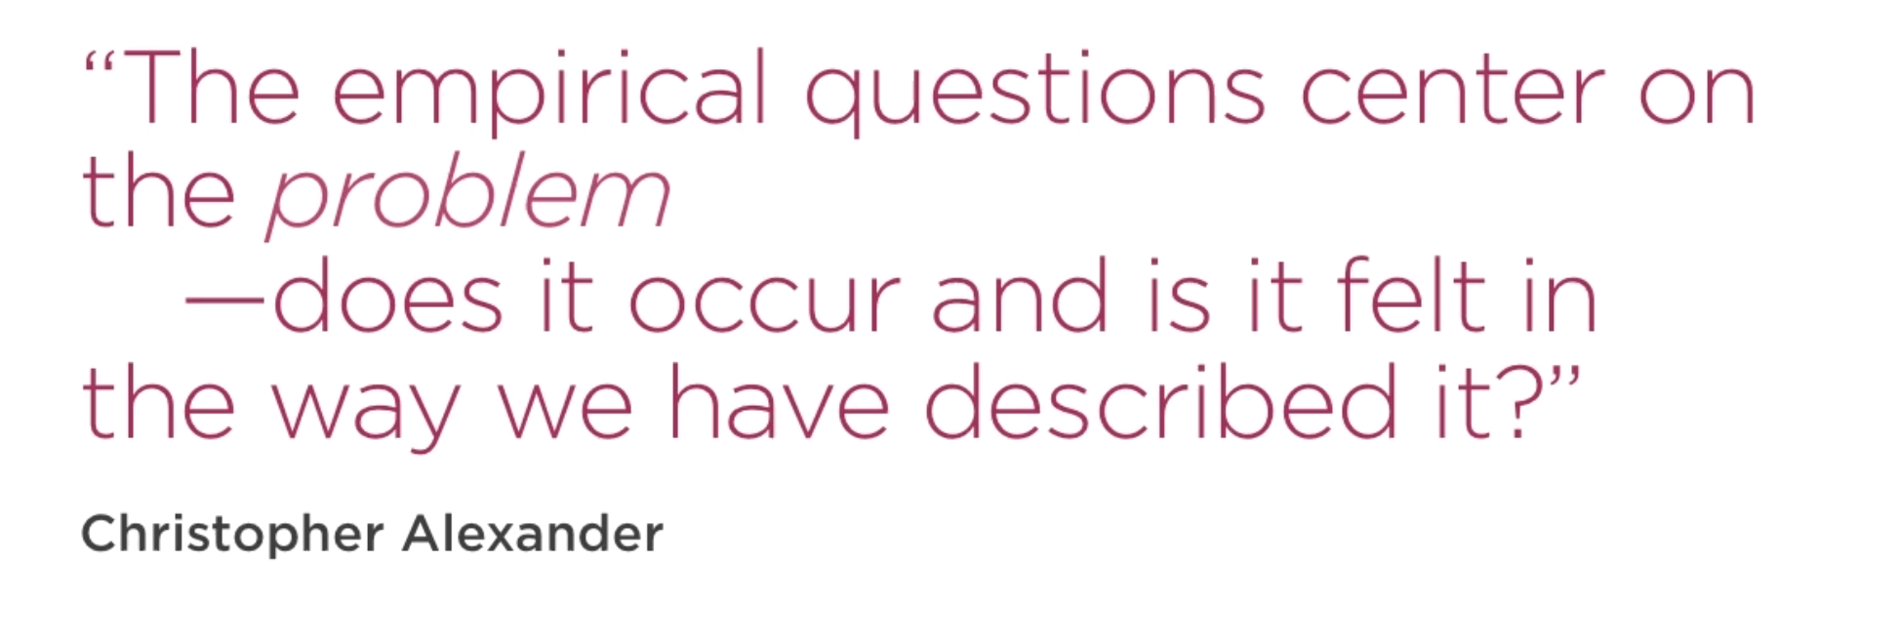
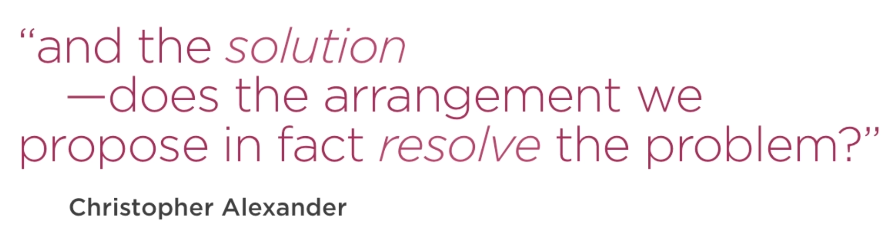
Design Patterns
3
Christopher Alexander

Slide 5
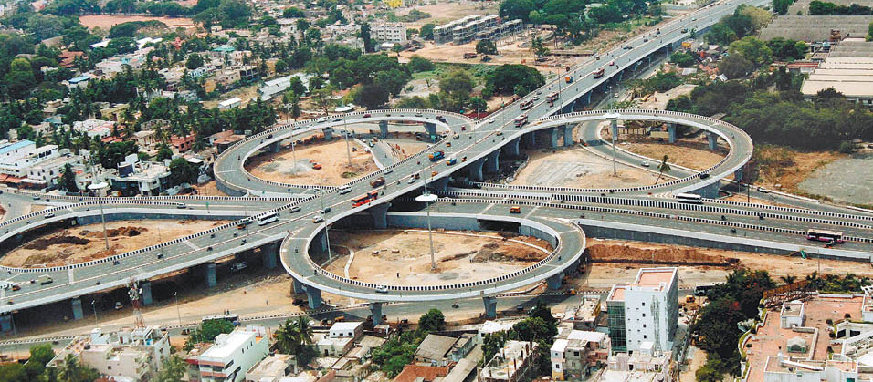
Problems and Solutions
On and Off Traffic Highways
Cloverleaf Interchange

Slide 6
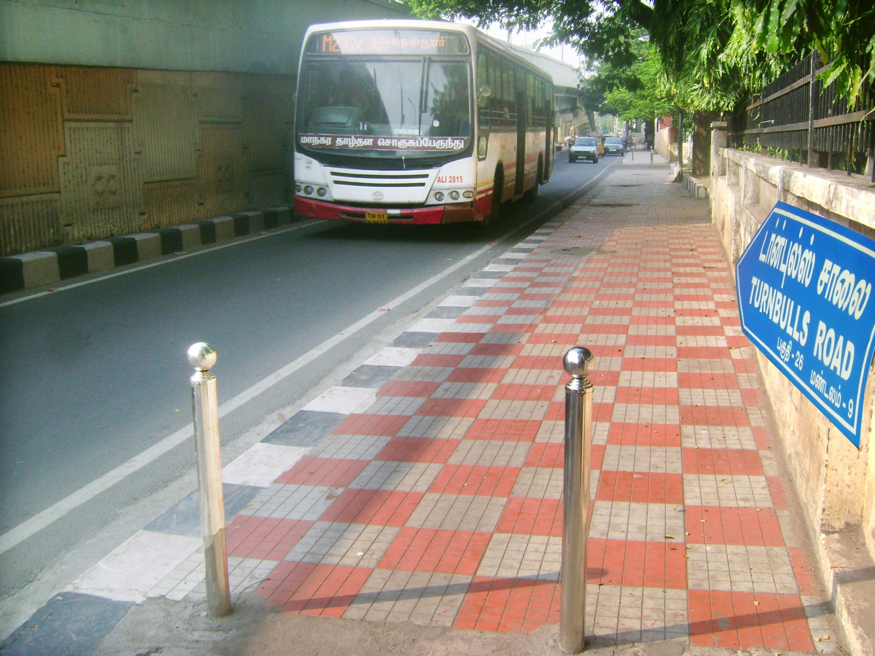
Pedestrian Traffic
Side Walks…

Slide 7
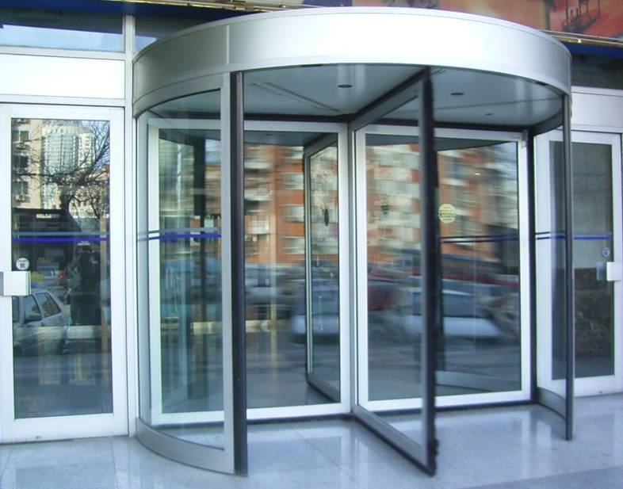
Entry and Exit for Buildings
Revolving Doors

Slide 8
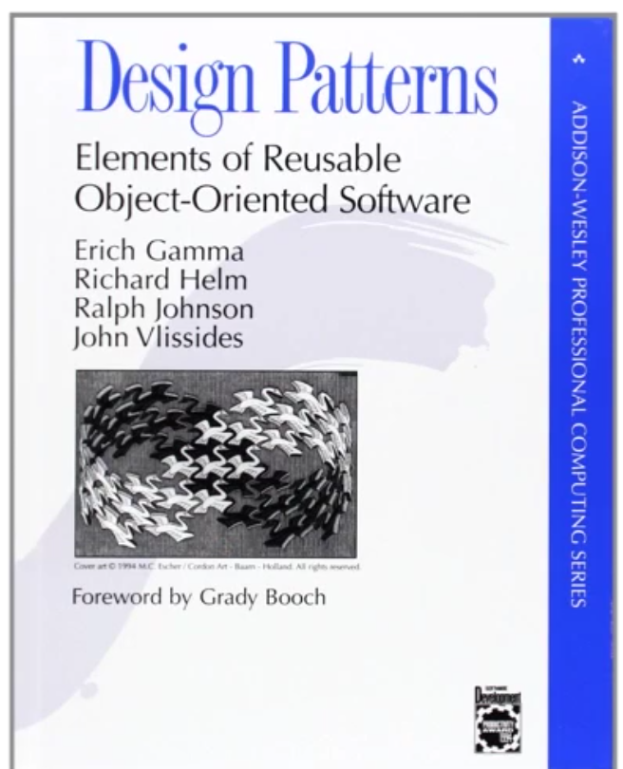
Entering the Gang of Four

Slide 9

What is Design Pattern
It solves a problem
It is a proven concept
It described a relationship
It has significant human component

Slide 10
Types of Design Pattern
Creational
1. Constructor
2. Module
3. Factory
Structural
1. Decorator
2. Façade
3. Proxy
Behavioral
1. Observer
2. Iterator

Slide 11
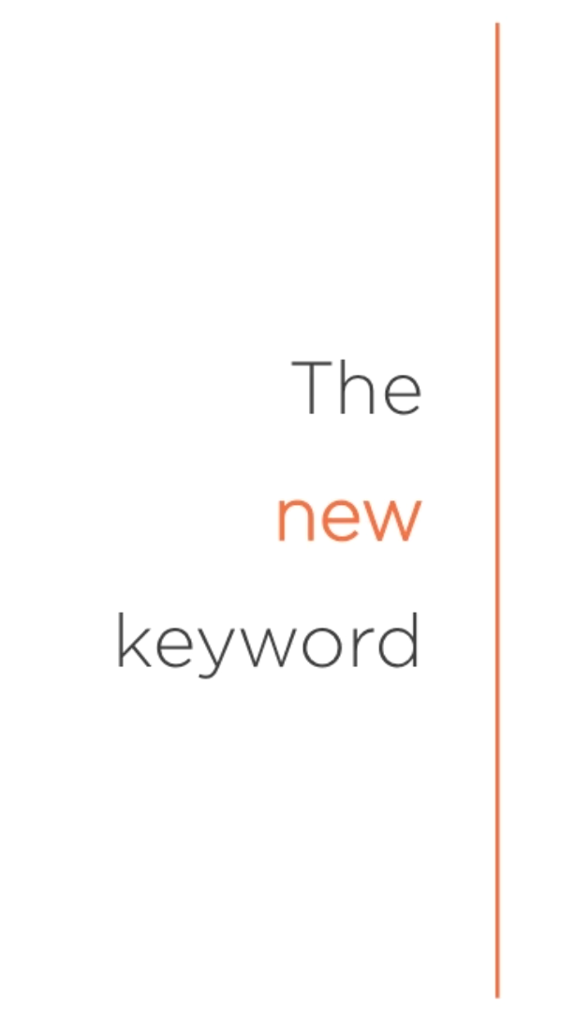
Constructor Pattern
Used to create new objects with their own object scope
Creates a brand new object
Links to an object prototype
Binds ‘this’ to the new object scope
Implicitly returns this

Slide 12
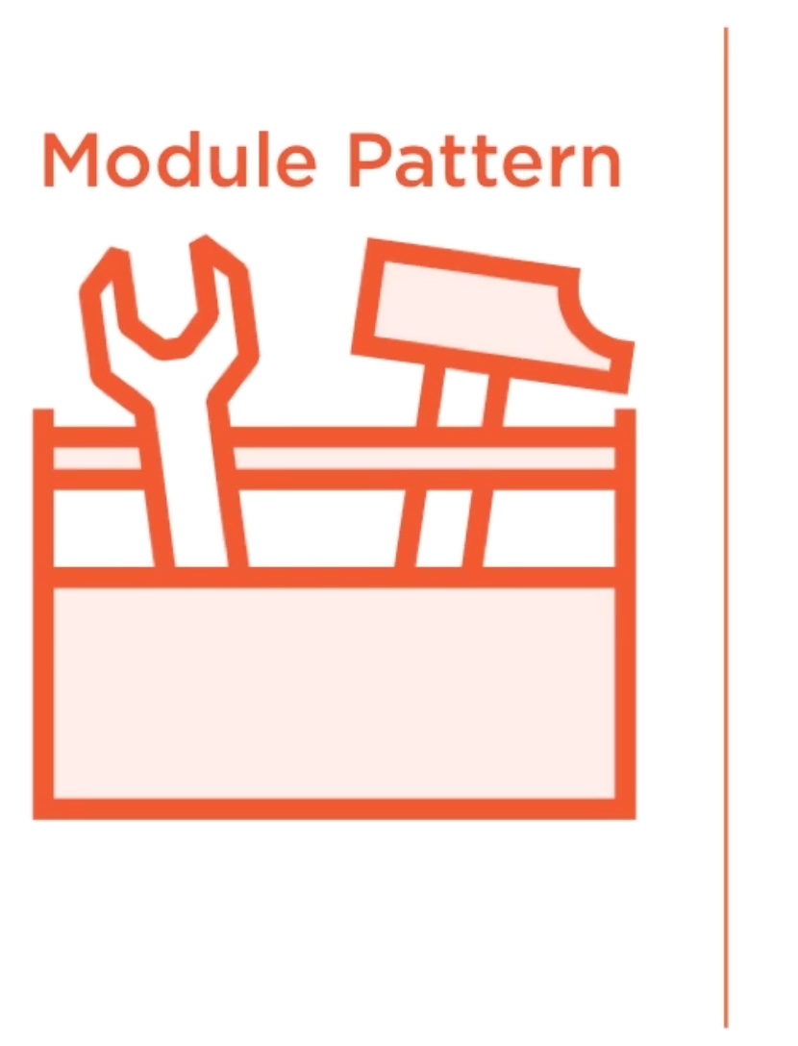
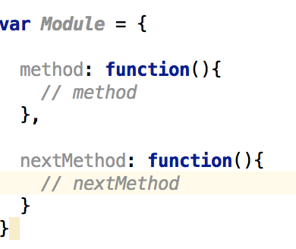
Module Pattern
Simple way to Encapsulate Methods
Creates a “Toolbox” of functions to use

Slide 13
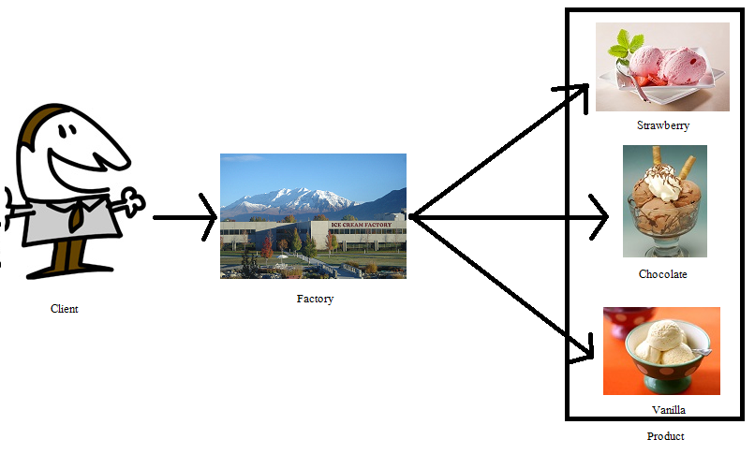
Factory Pattern
Used to simplify object creation
Simplifies object creation
Creating different objects based on need

Slide 14
Structural Pattern
Concerned with how objects are made up and simplify relationship between objects.
Deals with the relationship of objects
Extend / Simplify functionality

Slide 15
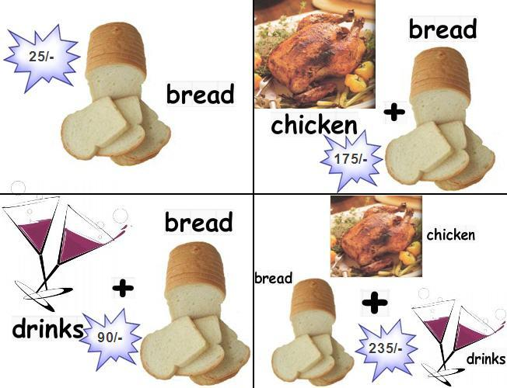
Decorator Pattern
Used to add new functionality to an existing object
More complete inheritance
It Wraps an object
Protect the existing object
Allows extended functionality

Slide 16

Facade Pattern
Used to provide a simplified interface to a complicated system
Think about the front of the building
Facade hides the complexity from us

Slide 17
Proxy Pattern
Proxy is “Substitute”
What do you substitute?
Why not just strict with the original?
A class represents functionality of another class
It is used when we want to provide controlled access

Slide 18
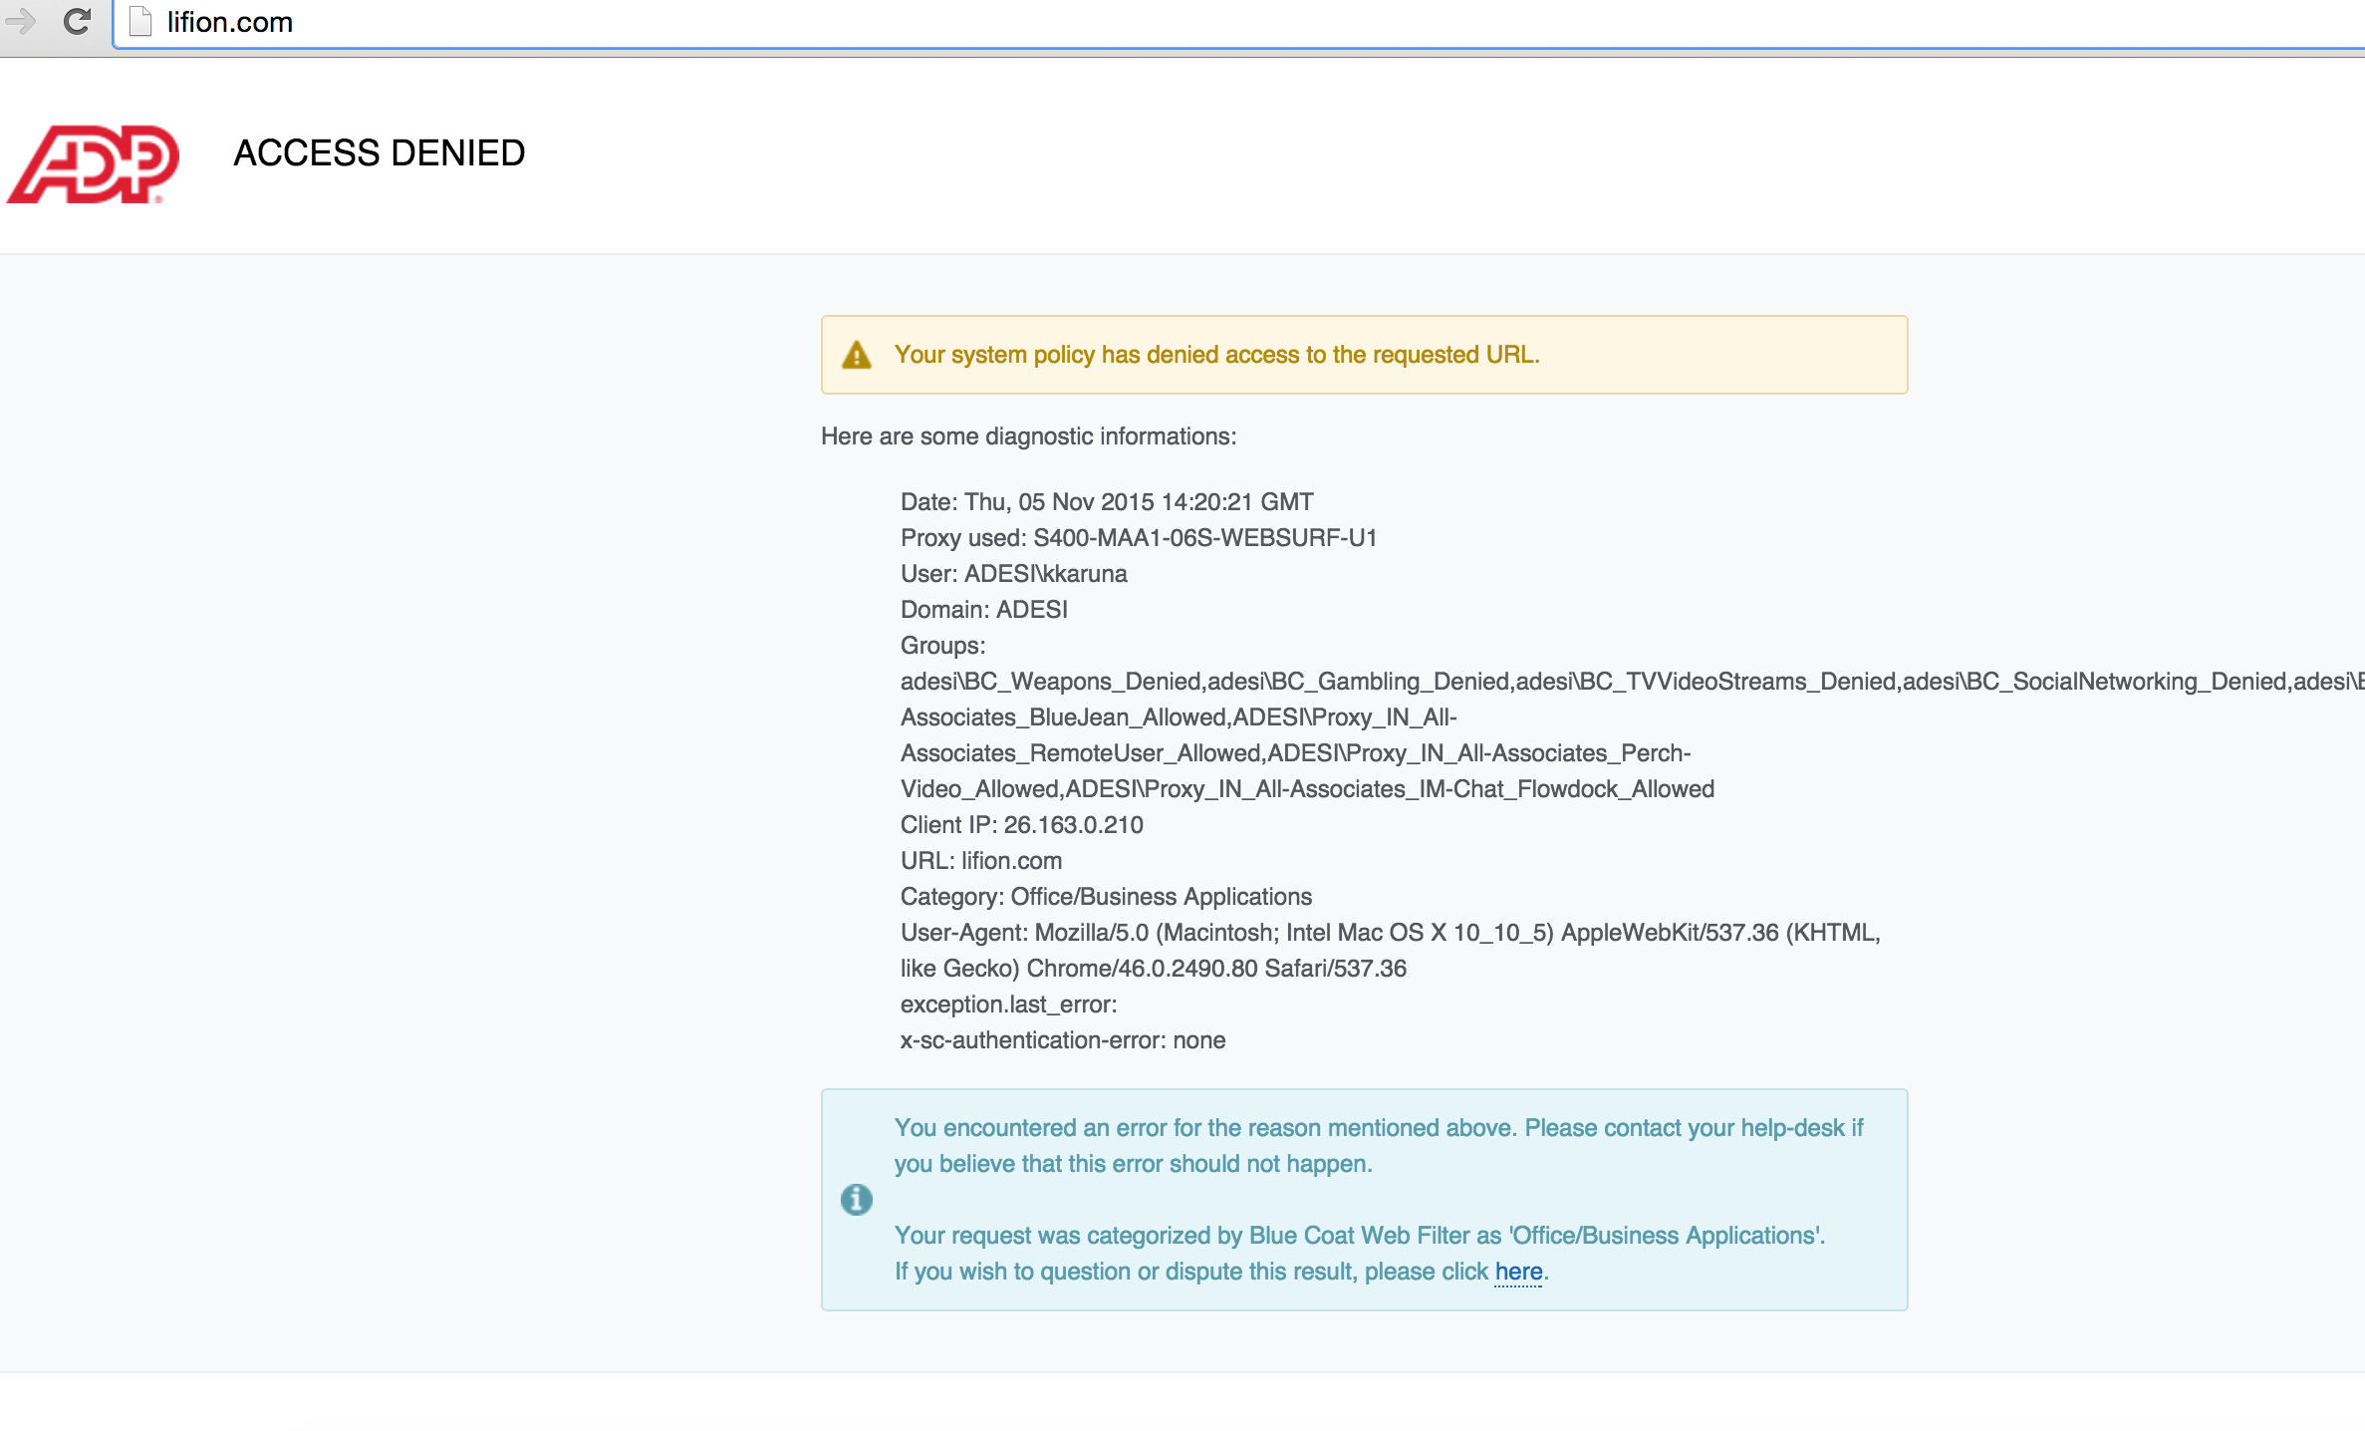

Slide 19
Behavioral Pattern
Deals with the responsibilities of object
Help objects co-operate
Assigns clear hierarchy

Slide 20
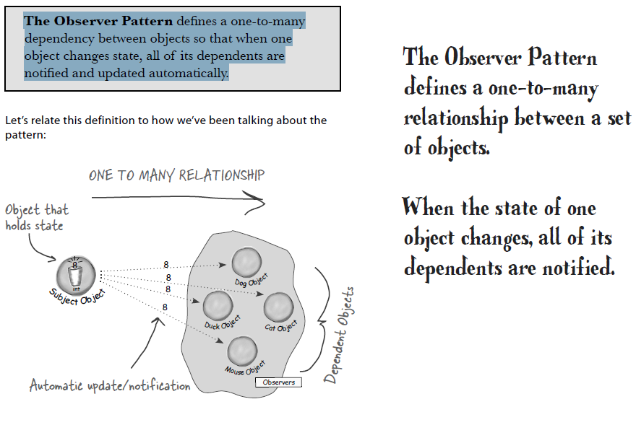
Observer Pattern

Slide 21
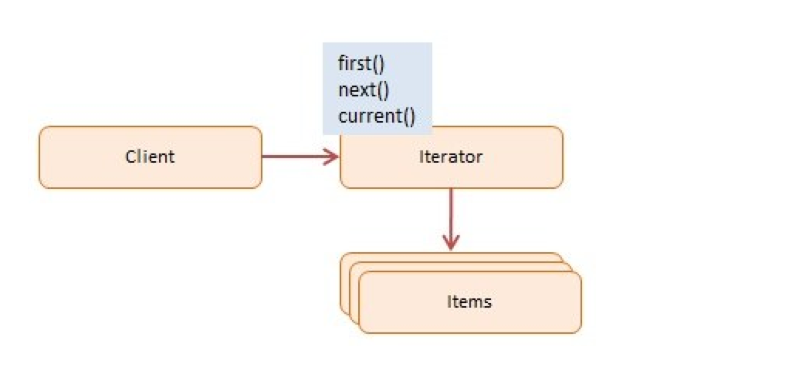
Iterator Pattern
It allows user to effectively loop over a client of objects
It allows us to design looping constructs that are far more flexible

